Slide 1
Realtime particle based fluid simulation
Stefan Auer

Slide 2
Contents
Introduction
Motivation
How to simulate fluids
Related work
Used techniques
Fluid simulation
Visualisation
Conclusion

Slide 3
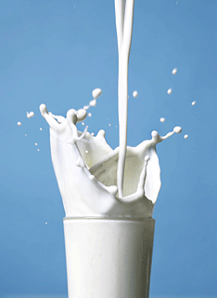
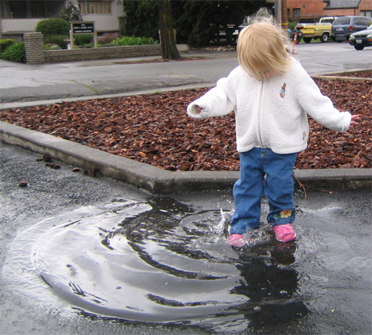
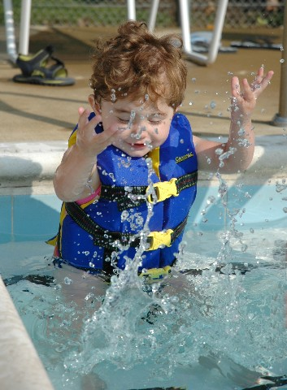
I.
Introduction
1)
Motivation
Fluids are ubiquitous parts of our environment
(fluids include liquids and gases, but our focus is on liquids)
Notes:
allgegenwärtig

Slide 4
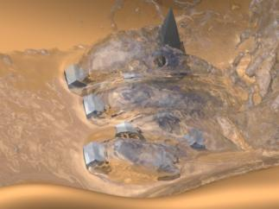
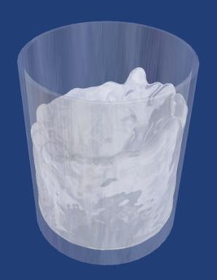
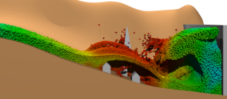
I.
Introduction
1)
Motivation
realtime computer graphics tries to simulate the world believable
dynamic fluids are rare in interactive applications
CFD is a big topic, but mainly offline
Notes:
„visually believable“; fluid simulation (computational) complex; CFD aims mostly on accuracy;
sometimes: r. t. vis. for offline sim.; left: offline, right: realtime

Slide 5
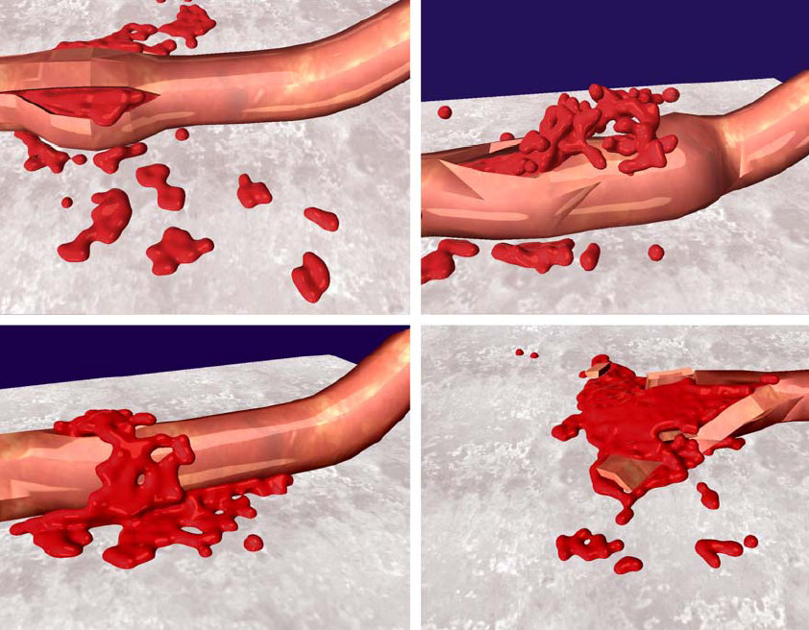

I.
Introduction
1)
Motivation
demand for fluids in interactive applications
“Particle-Based Fluid Simulation for Interactive Applications” (2003)
Notes:
left: surgical training environment, right: video game; paper from Müller et al. showed a way how it could be done;
many papers on the topic afterwards;

Slide 6

I.
Introduction
2)
How to simulate fluids
basis: Navier Stokes equations
mostly result in non-linear PDEs
-> numerical methods
common: discretize (grid) + finite differences (or FEM)
Notes:
Navier Stokes: fundamentals of modern CFD; more on them later; basis: fluid as continuum;
grid based called Eulerian models (later more why called Euler); disadvantage for i. apps: bounded simulation space

Slide 7
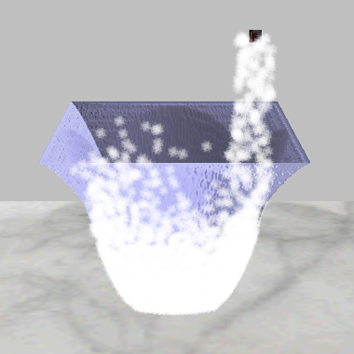
I.
Introduction
2)
How to simulate fluids
alternative to (Eulerian) grid based approach: particle based methods (Lagrangian)
represent fluid as set of particles
particle dynamics simulate fluid flow

Slide 8
I.
Introduction
2)
How to simulate fluids
advantages:
equations and computations become simpler
no numerical diffusions
partly easier surface construction
fluid can spread freely in space
Notes:
simpler eq.: implicit convection; num. diffusion: left image; surface constr. for grids i.e.: level-sets;
last point most important; because of this SPH was chosen

Slide 9
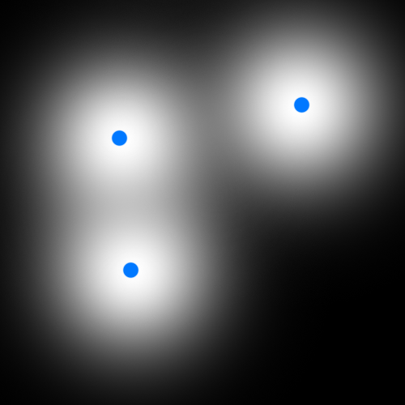
I.
Introduction
2)
How to simulate fluids
chosen technique: smoothed particle hydrodynamics
idea: particles distribute fluid properties in their neighbourhood
done via smoothing functions
Notes:
sum up contributions from neighbouring particles; later more

Slide 10
I.
Introduction
3)
Related work
SPH in general:
Developed by Gingold and Monaghan 1977
and independently by Lucy (1977 too)
first usage: astronomy (LARGE scale gas-dynamics)
later used for liquids too (beach waves, sloshing tanks, ...)
“SPH light” for interactive applications:
made public 2003 by Müller, Charypar, Gross: “Particle based fluid simulation for interactive appliactions”

Slide 11
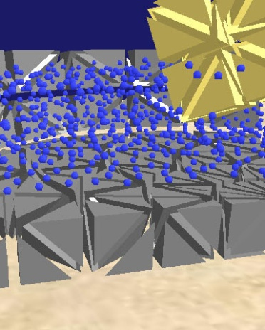
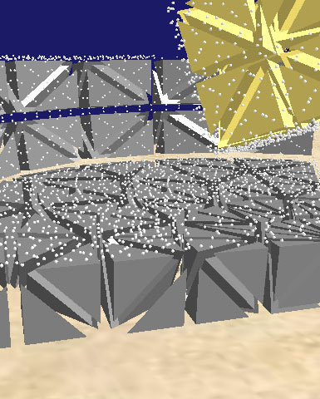
I.
Introduction
3)
Related work
following papers on realtime SPH:
Müller et al. 2004: “Interaction of fluids with deformable solids”
Kolb, Cuntz 2005: “Dynamic Particle Coupling for GPU-based Fluid Simulation”
Heinecke 2007: “Physikalische Rauchsimulation auf Partikelbasis in Echtzeit mit der PhysX-Engine“
Notes:
Müller: virtual surgery simulators; Kolb: avoid neighbour search with discrete grid; Heinecke: use of physic acceleration hardware

Slide 12
I.
Introduction
3)
Related work
good visualisations are important (and complex) too:
Müller suggests 2003 direct point splatting of the particles or marching cubes
“Acceleration Techniques for GPU-based Volume Rendering” (2003 by Krüger, Westermann) among other things: isosurface ray-casting
Co et al. 2003: iso-splatting
Kipfer, Westermann 2003: “carpet based” river visualisation
Müller et al. 2007; “screen space meshes”
Notes:
marching cubes: demands a discrete volumetric density field, GPU versions exist;
isosurface ray-casting: demands density field; iso-splatting: point based isosurface construction, demands density field;
Kipfer: 2.5 D; screen space meshes: no density grid, more at the end

Slide 13
I.
Introduction
4)
Used techniques
goal: simulation of water like liquids
believable movement
believable in optical appearance
implemented fluid simulation in short:
same “lightweight” SPH model as Müller 2003
neighbour search via dynamic grid
particles interact pair-wise
multi-core optimised

Slide 14
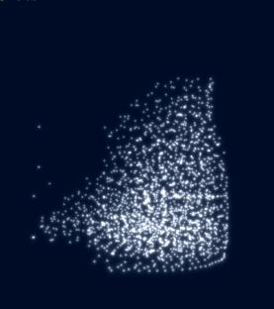
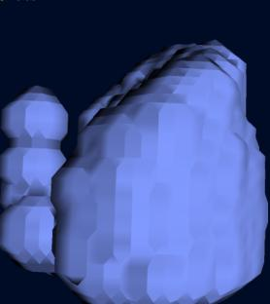
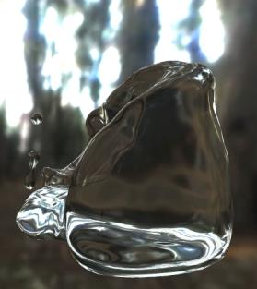
I.
Introduction
4)
Used techniques
implemented visualisations in short:
sprite-based direct particle rendering
marching cubes
isosurface ray-tracing
based on isosurface ray-casting
simulates multiple reflections and refractions
Notes:
sprites: mainly debug and tuning; mc: CPU based, experimenting with fast density field construction, tested how well suited for the task;
ray-tracing: GPU density field construction, optical effects relevant for water appeareance; main visualisation,

Slide 15
Contents
Introduction
Fluid simulation
Basics of fluid mechanics
Basics of smoothed particle hydrodynamics
Particle based, mathematical model of fluid motion
Smoothing kernels
Basic simulation algorithm
Implementation
Environment and user interaction
Multithreading optimisation
Results
Further work and outlook
Visualisation
Conclusion
Notes:
CFD and Navier Stokes descriptive explained, quantities introduced, difference between Euler and Lagrangian point of view
3) combines 1 and 2 to the simulation’s basic mathematical model
9) performance and simulation quality

Slide 16
II.
Fluid simulation
1)
Basics of fluid mechanics
treat fluid as continuum
every property has a defined value at each point in space
mathematically: vector- or scalar fields
fluid properties:
mass
“how much matter there is”
(mass-) density
“mass per volume”
Notes:
no inter-molecular effects; “Properties are macroscopic observable quantities that characterize the state of the fluid.”
L: small length significant greater than molecule spacing

Slide 17
II.
Fluid simulation
1)
Basics of fluid mechanics
fluid properties continued:
pressure
scalar quantity
force in normal direction on a surface
velocity
vector quantity
measures how fast fluid passes a fixed point
influences most other quantities (advection)
relevant for viscosity forces

Slide 18
II.
Fluid simulation
1)
Basics of fluid mechanics
fluid properties continued:
viscosity
compensates differences in flow velocity
comparable to friction
viscosity constant describes momentum transfer between adjacent regions of different flow speed
viscosity force: tangential force on a surface
surface tension
property of the surface
describes size of forces that try to minimize the surface

Slide 19
II.
Fluid simulation
1)
Basics of fluid mechanics
cause of surface tension (simple explanation)
surface molecules share cohesive forces with less neighbours
Notes:
cohesive forces (attractive forces between molecules of the same type)

Slide 20
II.
Fluid simulation
1)
Basics of fluid mechanics
now following: from Newtonian- to fluid mechanics
“derivation” of the Navier Stokes equation
no mathematical derivation
only one particular equation variant discussed
goal: understand basic concepts, meaning and components of the equation
basic statement:
“The Navier Stokes equation is the formulation of Newton’s second law of motion for fluids.”

Slide 21
II.
Fluid simulation
1)
Basics of fluid mechanics
Newton’s second law of motion:
in Newtonian mechanics usually interpreted from the Lagrangian point of view:
observer follows a moving object
with fluids: watch always the same “amount of fluid”
alternative: Eulerian point of view
observe always the same point in space
with fluids: watched “amount of fluid” changes when fluid moves
Notes:
second law = conservation of momentum (F=0 -> mv constant)

Slide 22
II.
Fluid simulation
1)
Basics of fluid mechanics
Eulerian vs. Lagrangian point of view:
Notes:
Eulerian observer watches two types of changes

Slide 23
II.
Fluid simulation
1)
Basics of fluid mechanics
acceleration in Lagrangian point of view:
(simple) time derivative of velocity
acceleration in Eulerian point of view:
convective derivative of velocity
convective derivative:
Newton’s second law becomes:
Notes:
convective derivative = substantial d. = substantive d. = material d.;
convection = advection + diffusion (two forms of property distribution that must be taken into account);
advection = transport of properties together with the mass; partial derivative: local changes; v dot DEL: changes due to advection; DEL v: velocity gradient (Jacobian matrix)

Slide 24
II.
Fluid simulation
1)
Basics of fluid mechanics
a certain volume element is watched
mass in a volume is given by density ->
split forces in fluid forces and external forces:

Slide 25
II.
Fluid simulation
1)
Basics of fluid mechanics
external forces mainly gravity
typically specified as acceleration (F=mg)
mass still depends on density ->

Slide 26
II.
Fluid simulation
1)
Basics of fluid mechanics
for the next step assume:
fluid is Newtonian
viscous stress proportional to velocity gradient
in common words: viscosity is a constant that doesn’t change with different shear rates
fluid satisfies the incompressible flow condition
no sources or sinks in the velocity field
counter example: air that heats up
also flows of compressible fluid can satisfy the condition
Notes:
all fluids are compressible to some amount; regular air flow till mach 0.3 satisfies incompr. f. c.

Slide 27
II.
Fluid simulation
1)
Basics of fluid mechanics
if all that’s the case, fluid forces can simply be split up:
pressure force
depends only on pressure differences
points from high- to low pressure areas
-> the negative pressure gradient is what we want
Notes:
otherwise it would be more complicated;
negative pressure gradient points from high to low pressure and its size represents the difference in pressure

Slide 28
II.
Fluid simulation
1)
Basics of fluid mechanics
viscosity force
because of the incompressible flow condition it becomes the simple term:
just believe it or see “Viscous fluid flow” (1999 by Papanastasiou et al.) for mathematical derivation
Laplacian operator measures how far a quantity is from the average around it
-> the force smoothes the velocity differences over time
this is what viscosity should do

Slide 29
II.
Fluid simulation
1)
Basics of fluid mechanics
inserting viscosity force we arrive at Newton’s second law for fluids, the Navier Stokes equation:
(more exactly: Navier Stokes momentum equation for incompressible, Newtonian fluids)
which hopefully now is somehow understandable
Notes:
short description; rho density->mass; convective term: acceleration; right: forces (pressure, viscosity, gravity)

Slide 30
Contents
Introduction
Fluid simulation
Basics of fluid mechanics
Basics of smoothed particle hydrodynamics
Particle based, mathematical model of fluid motion
Smoothing kernels
Basic simulation algorithm
Implementation
Environment and user interaction
Multithreading optimisation
Results
Further work and outlook
Visualisation
Conclusion

Slide 31
II.
Fluid simulation
2)
Basics of smoothed particle hydrodynamics
SPH was developed for astrophysical gas dynamics problems
as in many other numerical solutions, values are interpolated from a discrete set of points
SPH derives from the integral interpolation:
W: smoothing function (kernel)
Notes:
A: physical quantity at a position r; r’: position of an interpolation point;
W: radial symmetric; h: smoothing length;

Slide 32
II.
Fluid simulation
2)
Basics of smoothed particle hydrodynamics
a word on the smoothing kernel:
“spreads a quantity in its surroundings”
is even (radial symmetric)
is normalised:
tends to become the delta function for h tending to zero (for h=0 the integral would reproduce A exactly)
for us: h = radius of support

Slide 33
II.
Fluid simulation
2)
Basics of smoothed particle hydrodynamics
SPH is a Lagrangian method
moveable mass elements (particles) that carry properties
particle positions are the discrete set of interpolation points
interpolation integral becomes interpolation sum:
mass density coefficient appears because each particle represents a volume:

Slide 34
II.
Fluid simulation
2)
Basics of smoothed particle hydrodynamics
interesting example:
SPH interpolation applied to density
-> for SPH the density is simply the smoothed mass of the particles
in practical use not all particles must be evaluated
consider only particles that are within the radius of support (=h for us)

Slide 35
II.
Fluid simulation
2)
Basics of smoothed particle hydrodynamics
advantage of SPH: simple derivatives
derivatives are very common in fluid equations
with SPH only the smoothing function has to be differentiated
the gradient therefore becomes:

Slide 36
II.
Fluid simulation
2)
Basics of smoothed particle hydrodynamics
according to Müller this can be applied for the Laplacian too:
this formulations are not “physically bullet-proof”
resulting equations can violate physical laws
-> correct them were necessary
also different definitions for SPH gradient and Laplacian exist in the literature

Slide 37
Contents
Introduction
Fluid simulation
Basics of fluid mechanics
Basics of smoothed particle hydrodynamics
Particle based, mathematical model of fluid motion
Smoothing kernels
Basic simulation algorithm
Implementation
Environment and user interaction
Multithreading optimisation
Results
Further work and outlook
Visualisation
Conclusion

Slide 38
II.
Fluid simulation
3)
Particle based, mathematical model of fluid motion
combine Navier Stokes equation with basic SPH rules
discrete number of particles
particles carry only:
mass (constant and equal for all particles)
position
Velocity
all other quantities derived using SPH and basic physics equations

Slide 39
II.
Fluid simulation
3)
Particle based, mathematical model of fluid motion
Eulerian models need equations for:
conservation of momentum (Navier Stokes)
conservation of mass (continuity equation)
conservation of energy (only sometimes)
SPH needs only momentum equation
particle count and -masses constant -> mass constant

Slide 40
II.
Fluid simulation
3)
Particle based, mathematical model of fluid motion
Eulerian models need convective derivative
because of advection
SPH can use simple time derivative
advection implicit, because properties are carried with the particles
-> replace convective derivative in N. S. equation with time derivative
leads to momentum equation for a single particle:
Notes:
F_i: forces on particle i; rho_i: density at position of particle i (->mass)

Slide 41
II.
Fluid simulation
3)
Particle based, mathematical model of fluid motion
particle acceleration therefore becomes simply:
remember the SPH example for the density?
all what’s missing is pressure- and viscosity force

Slide 42
II.
Fluid simulation
3)
Particle based, mathematical model of fluid motion
pressure force
SPH rules would lead to the following pressure term:
unfortunately this force is not symmetric (think of two particles with different pressure)
fortunately a symmetric pendant is easy to find
use the arithmetic mean pressure:
Notes:
gradient is zero at the centre -> particle i uses only pressure from j and vice versa

Slide 43
II.
Fluid simulation
3)
Particle based, mathematical model of fluid motion
pressure force continued
now we need the scalar pressure at the particle’s position
Müller suggests the ideal gas state equation:
this introduces some drawbacks (compressibility i.e.)
we accept them for a simple simulation model
Notes:
k gas constant (dependent on temperature); rho_0: rest density

Slide 44
II.
Fluid simulation
3)
Particle based, mathematical model of fluid motion
viscosity force
the SPH rule delivers:
again asymmetric ☹, but again easy to symmetrise ☺
viscosity depends only on velocity differences ->
the viscosity force in our model hence accelerates each particle to meet the relative speed of its environment

Slide 45
II.
Fluid simulation
3)
Particle based, mathematical model of fluid motion
now we would be finished as we have equations for all what’s covered by the N. S. equation... ☺
... but because we deal with much free surface, we will consider surface tension too ☹

Slide 46

II.
Fluid simulation
3)
Particle based, mathematical model of fluid motion
surface tension force
applies only to particles near the surface
pushes particles towards the inner of the fluid (-> negative surface normal)
higher surface curvature -> higher surface tension force
the colour-field can deliver us all that
its gradient delivers the surface normal and is a measure for the surface-closeness
its Laplacian measures the surface curvature

Slide 47
II.
Fluid simulation
3)
Particle based, mathematical model of fluid motion
in short the surface-tension term looks like this:
is near to zero for inner particles
-> surface tension only evaluated where it exceeds a threshold
now our fluid model is complete ☺ ☺
Notes:
kappa: curvature; sigma: surface tension coefficient

Slide 48
II.
Fluid simulation
4)
Smoothing kernels
three different smoothing kernels are used:
poly6
advantage: r appears only squared (no square roots)
used everywhere except for pressure and viscosity terms
spiky
gradient doesn’t vanish near the centre
used for pressure
viscosity
Laplacian stays positive everywhere
used for viscosity

Slide 49
II.
Fluid simulation
4)
Smoothing kernels
used smoothing kernels:
poly6
spiky
viskosity

Slide 50
Contents
Introduction
Fluid simulation
Basics of fluid mechanics
Basics of smoothed particle hydrodynamics
Particle based, mathematical model of fluid motion
Smoothing kernels
Basic simulation algorithm
Implementation
Environment and user interaction
Multithreading optimisation
Results
Further work and outlook
Visualisation
Conclusion

Slide 51
II.
Fluid simulation
5)
Basic simulation algorithm
basically the simulation consists of 3 steps
compute the density for each particle
accumulate the contributions of all neighbours
apply density equation
compute forces and colour-field for each particle
accumulate the contributions of all neighbours
apply force and colour-field equations
move each particle
linearly process one particle after another
calculate total force, acceleration
leads to new velocity and position

Slide 52
II.
Fluid simulation
5)
Basic simulation algorithm
step 1
step 2 uses the same evaluation scheme
applies the force and colour-field equations
step 3 just processes all particles linearly
combines the results and calculates new positions and velocities
foreach particle in fluid-particles
foreach neighbour in fluid-particles
r ← position of particle – position of neighbour
if length of r ≤ h
add mass * W_poly6(r, h) to density of particle
end-if
end-foreach
end-foreach

Slide 53
II.
Fluid simulation
6)
Implementation
implementation consists of the 3 steps plus update of the acceleration structures
transferred between simulation steps:
only particle position and velocity
all other per-particle data stored in separate arrays
density calculation is the first step that performs the summation
must implement a neighbour-search to avoid quadratic computation complexity

Slide 54
II.
Fluid simulation
6)
Implementation
neighbour-search
crucial for the overall performance
different solutions in the literature
used data-structure: grid with cell-size equal to radius of support
Notes:
reduces complexity from O(n²) to O(nm); m=number of particles per cell

Slide 55
II.
Fluid simulation
6)
Implementation
further optimisation: exploitation of symmetry
neighbour offsets
in 3D case:
----↓---- ----↑----
(-1,-1,-1) ( 1, 1, 1)
(-1,-1, 0) ( 1, 1, 0)
(-1,-1, 1) ( 1, 1,-1)
(-1, 0,-1) ( 1, 0, 1)
(-1, 0, 0) ( 1, 0, 0)
(-1, 0, 1) ( 1, 0,-1)
(-1, 1,-1) ( 1,-1, 1)
(-1, 1, 0) ( 1,-1, 0)
(-1, 1, 1) (1,-1,-1)
( 0,-1,-1) (0, 1, 1)
( 0,-1, 0) (0, 1, 0)
( 0,-1, 1) (0, 1,-1)
( 0, 0,-1) (0, 0, 1)
( 0, 0, 0)→( 0, 0, 0)

Slide 56
II.
Fluid simulation
6)
Implementation
all found particle pairs are stored temporarily
-> step 2 don’t has to perform the neighbour search again
calculation of movement rather trivial
Newton’s law leads from total force to acceleration (a=F/m)
new velocity = old velocity + elapsed time * acceleration
new position = old position + elapsed time * ½ * (old velocity + new velocity)

Slide 57
Contents
Introduction
Fluid simulation
Basics of fluid mechanics
Basics of smoothed particle hydrodynamics
Particle based, mathematical model of fluid motion
Smoothing kernels
Basic simulation algorithm
Implementation
Environment and user interaction
Multithreading optimisation
Results
Further work and outlook
Visualisation
Conclusion

Slide 58
II.
Fluid simulation
7)
Environment and user interaction
environment and user interaction should be simulated
-> the fluid is contained in a (imaginary) glass, which can be moved with the mouse
well known scenario
allows long time interaction
one way interaction (fluid doesn’t influence glass)
glass simple to model
simple collision code

Slide 59
II.
Fluid simulation
7)
Environment and user interaction
“glass -> particle” interaction handled in the same was as “particle <-> particle” interaction
-> extra steps for glass related density calculation and glass related forces calculation added
-> simulation now consists of 6 steps:
update densities (particle <-> particle)
update densities (glass -> particle)
update pressure forces, viscosity forces and colour field (particle <-> particle)
update pressure and viscosity forces (glass -> particle)
move particles, enforce glass boundary, clear fields
update the neighbour search grid

Slide 60
Contents
Introduction
Fluid simulation
Basics of fluid mechanics
Basics of smoothed particle hydrodynamics
Particle based, mathematical model of fluid motion
Smoothing kernels
Basic simulation algorithm
Implementation
Environment and user interaction
Multithreading optimisation
Results
Further work and outlook
Visualisation
Conclusion

Slide 61
II.
Fluid simulation
8)
Multithreading optimisation
consumer PCs equipped with multi-core CPUs
multi-threading necessary to utilise their full power
step-based simulation -> very short reoccurring tasks
no task-parallelism possible -> utilize data-parallelism
-> thread manager (pool) to avoid expensive thread creations and control job handover
5 of the 6 steps where made multi-threaded

Slide 62
II.
Fluid simulation
8)
Multithreading optimisation
step 1: “particle <-> particle” density calculation
neighbour search multi-threaded
grid cells distributed among threads
problem: particle pairs between different cells
two threads could simultaneous try to add their contribution to the same particle
add operation not atomic -> summand could get swallowed
-> synchronisation (i.e. atomic ops) ?
NO: would eliminate performance gain
instead: only make density volatile and accept extremely rare collisions (no big failure)

Slide 63
II.
Fluid simulation
8)
Multithreading optimisation
step 3: force and colour-field calculation
each thread gets its own pair-list from step 1
arrays volatile again
steps 2, 4, 5
each thread processes the same count of particles
no collisions possible
step 6: update of the neighbour-search-grid
not parallelisable in a reasonable way

Slide 64
Contents
Introduction
Fluid simulation
Basics of fluid mechanics
Basics of smoothed particle hydrodynamics
Particle based, mathematical model of fluid motion
Smoothing kernels
Basic simulation algorithm
Implementation
Environment and user interaction
Multithreading optimisation
Results
Further work and outlook
Visualisation
Conclusion

Slide 65
II.
Fluid simulation
9)
Results
performance results:
test machine:
CPU: Intel Core 2 Quad Q6600 @ 3.2 GHz
RAM: 2 GB
simulation of all possible forces
sprite visualisation active (no measureable overhead)
1728 (12³) particles: 330 FPS
10648 (22³) particles: 53 FPS
27000 (30³) particles: 14 FPS

Slide 66
II.
Fluid simulation
9)
Results
plausibility of the fluids behaviour
harder to measure
simulates all major effects that are observable at real fluids in real glasses
vortex formation
wave breaking
wave reflection
drop formation
drops draining down the side of the glass

Slide 67
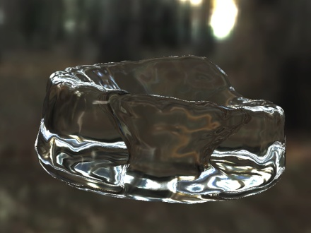
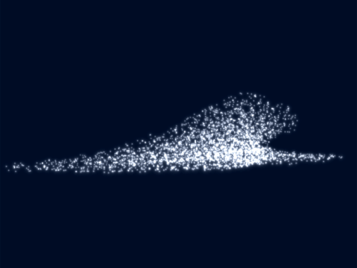
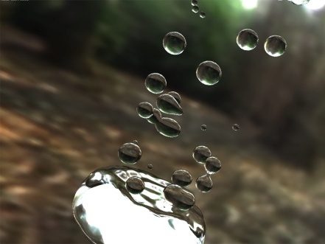
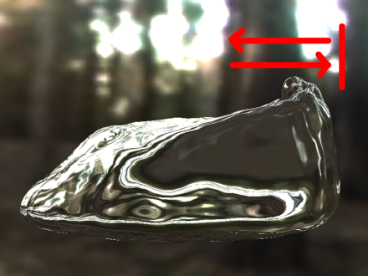
II.
Fluid simulation
9)
Results
examples

Slide 68
II.
Fluid simulation
9)
Results
demonstration?

Slide 69
II.
Fluid simulation
10)
Further work
incompressibility
some ideas in the literature
but apparently none used in a realtime simulation so far
surface tension
colour-field Laplacian problematic
model based on cohesive forces proposed by Becker and Teschner
similar model already implemented

Slide 70
II.
Fluid simulation
10)
Further work
environment interaction
support a richer environment
simulate obstacles with virtual particles
would also make two-way interaction very easy (-> i.e. interaction with rigid body simulation)
mapping from conventional geometric objects to particles required
high total number of particles
alternative: interact with simplified geometry
perhaps more efficient

Slide 71
II.
Fluid simulation
10)
Further work
neighbour search
current approach not greatly spatial flexible
destroys advantage of particle approach somewhat
use hashing algorithms to map unlimited space partitions to limited amount of slots
consider different space partitioning algorithms
target hardware
implement simulation on the GPU
wait for CPU manufactures to provide SPMD optimised hardware
Intel: Larrabee (x86 GPU)
AMD: Fusion (later products)
Notes:
SPMD single program multiple data

Slide 72
Contents
Introduction
Fluid simulation
Visualisation
Target graphics APIs
Direct particle rendering
Isosurface rendering with marching cubes
GPU-based isosurface raytracing
GPU-based volumetric density field construction
Alternatives and further work
Conclusion

Slide 73
III.
Visualisation
1)
Target graphics APIs
in short:
sprite rendering and marching cubes implemented for D3D 9 (entirely fixed function) and D3D 10
isosurface ray-casting D3D10 exclusive
makes use of geometry shaders
makes use of way more flexible render target choice
makes heavy use of branching and flow control
is portable, but would become far less elegant with D3D9
introduction to D3D10 in the thesis (but you can just as well read the material from Microsoft)

Slide 74
Contents
Introduction
Fluid simulation
Visualisation
Target graphics APIs
Direct particle rendering
Isosurface rendering with marching cubes
GPU-based isosurface raytracing
GPU-based volumetric density field construction
Alternatives and further work
Conclusion

Slide 75
III.
Visualisation
3)
Direct particle rendering
useful for:
analysis of the particle behaviour
simulation debugging
visualisation of fluid properties (size-, transparency- or colour-coding)
D3D9 implementation
fixed function point sprite functionality used
D3D10 implementation
geometry shader used

Slide 76
Contents
Introduction
Fluid simulation
Visualisation
Target graphics APIs
Direct particle rendering
Isosurface rendering with marching cubes
GPU-based isosurface raytracing
GPU-based volumetric density field construction
Alternatives and further work
Conclusion

Slide 77
III.
Visualisation
3)
Isosurface rendering with marching cubes
clear water is fairly transparent
the inner of the water don’t has to be visualised
but the water surface exhibits some interesting optical phenomena
-> render only the water surface
how to describe the surface in a fluid simulation?
common approach:
take a discrete density grid as basis
find isosurfaces

Slide 78
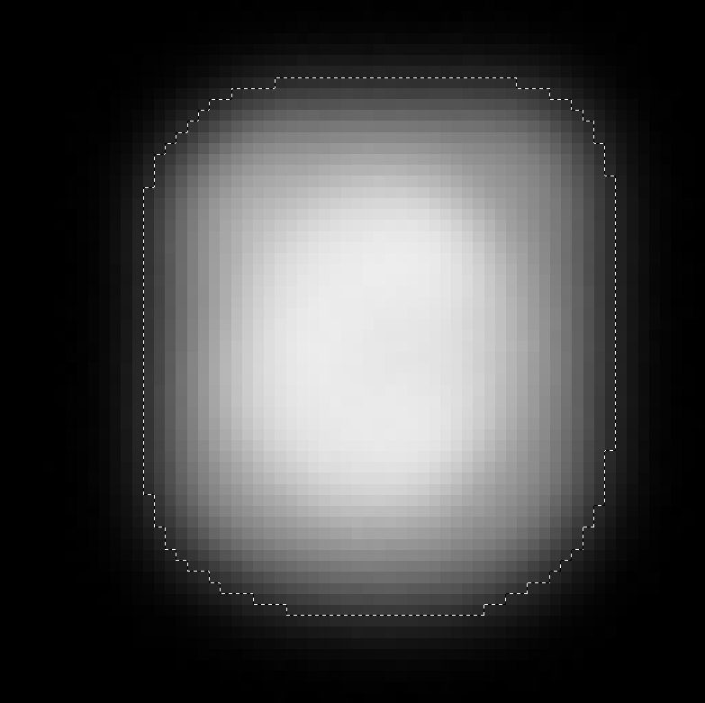
III.
Visualisation
3)
Isosurface rendering with marching cubes
what is a isosurface?
ἴσος / isos is Greek and means “equal”
an isosurface is a region of a volumetric scalar-field where all values are equal
when the field fulfils some conditions this region has the form of a 2D surface (orientable 2 manifold without boundaries)
when domain and range are discrete define isosurface as area between regions lower and regions equal or higher than the isovalue

Slide 79
III.
Visualisation
3)
Isosurface rendering with marching cubes
marching cubes
common technique to construct a renderable triangle mesh of the isosurface
piecewise process the grid
8 densities values form a graph in form of a cube
find intersections of the edges with the isosurface
for each intersection create a vertex (linear interpolation)

Slide 80
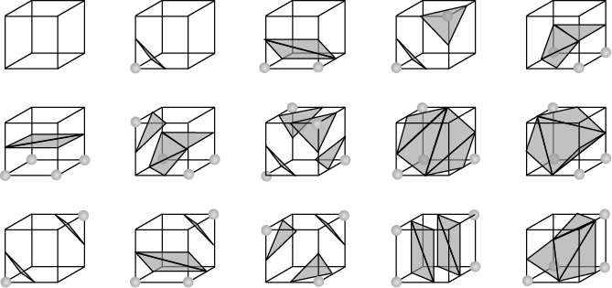
III.
Visualisation
3)
Isosurface rendering with marching cubes
marching cubes continued
8-bit corner-code (1 corner below, 0 otherwise) identifies the 256 possible triangle configurations (15 distinct)

Slide 81
III.
Visualisation
3)
Isosurface rendering with marching cubes
implementation optimisation:
reuse the pre-calculated data of precursor cube

Slide 82
III.
Visualisation
3)
Isosurface rendering with marching cubes
density field construction, simple approach
for each particle consider all voxels within a cube around the particle
for each of these voxels calculate the additional density and add it to the voxels value
Notes:
cube side length: 2*radius of support

Slide 83
III.
Visualisation
3)
Isosurface rendering with marching cubes
density field construction, stamp approach
assume that particle movement inside one voxel has no significant affect on the densities
construct a stamp containing precomputed additional densities
during construction, only identify the voxel the particle lies in and apply the stamp

Slide 84
III.
Visualisation
3)
Isosurface rendering with marching cubes
results
test machine runs density field construction, marching cubes mesh creation and visualisation rendering at 150 FPS for 1728 particle and 0.9³ voxel-size
with activated simulation: 113 FPS (-> algorithm is slow)
voxel-size has great influence: 1.8³ -> 499 FPS, 0.4³ -> 17 FPS
mesh construction only (295 FPS) is faster then grid creation only (220 FPS)
mesh rendering only is so fast that it’s not measurable (same FPS as program doing “nothing”)

Slide 85
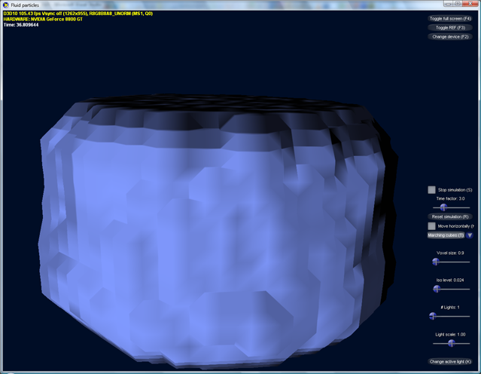
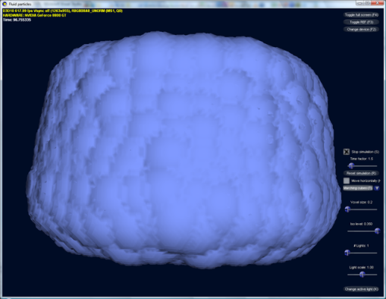
III.
Visualisation
3)
Isosurface rendering with marching cubes
optical results:
voxel-size 0.9³
voxel-size 0.1³

Slide 86
III.
Visualisation
3)
Isosurface rendering with marching cubes
pros
triangle mesh is exactly what 3D APIs are intended for
-> bunch of visualisation method applicable
cons
realtime density and mesh creation to expensive
mesh looks square-cut despite interpolations
low voxel sizes result in over tessellated meshes

Slide 87
III.
Visualisation
3)
Isosurface rendering with marching cubes
further work
use mesh smoothing
use GPU-based density grid construction
will be introduced later
use GPU-based marching-tetrahedra algorithm
available in Nvidia SDK 10

Slide 88
Contents
Introduction
Fluid simulation
Visualisation
Target graphics APIs
Direct particle rendering
Isosurface rendering with marching cubes
GPU-based isosurface raytracing
GPU-based volumetric density field construction
Alternatives and further work
Conclusion

Slide 89
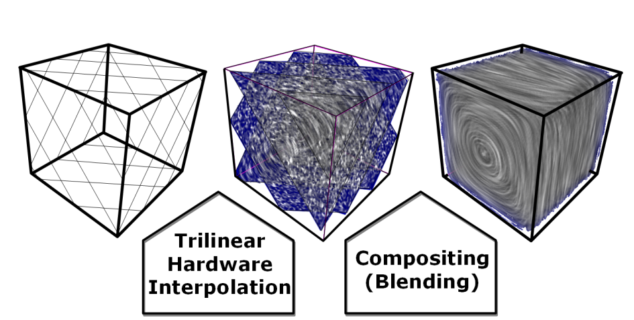
III.
Visualisation
4)
GPU-based isosurface raytracing
direct volume rendering (DVR) often implemented via 3D texture slicing:
disadvantage: only small percentage of the drawn (and textured) fragments contribute to the final image

Slide 90
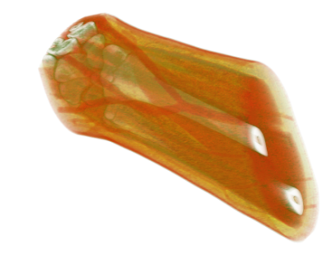
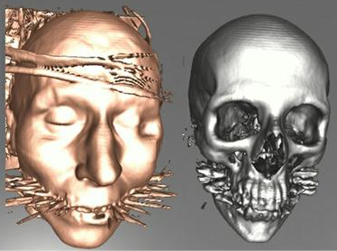
III.
Visualisation
4)
GPU-based isosurface raytracing
therefore, Krüger and Westermann suggested volume ray-casting to perform only contributing texture samples
ray-casting allows also iso-surface visualisation

Slide 91
III.
Visualisation
4)
GPU-based isosurface raytracing
volume ray-casting principle

Slide 92
III.
Visualisation
4)
GPU-based isosurface raytracing
isosurface ray-casting hit refinement

Slide 93
III.
Visualisation
4)
GPU-based isosurface raytracing
ray creation
render bounding box back faces first, then front faces
leads to position of entry and exit point
sampling
ray-cast passes calculate M sampling points along the ray and sample the volumetric texture
texture size not equal on each dimension -> per pixel step-size required

Slide 94
III.
Visualisation
4)
GPU-based isosurface raytracing
cause of per pixel step-size

Slide 95
III.
Visualisation
4)
GPU-based isosurface raytracing
ray termination
after each sampling pass a intermediate pass checks the stop criterion (opacity reached, isosurface hit)
when criterion matched, z-buffer is set to maximum -> early z-test skips pixel/ray in following passes

Slide 96
III.
Visualisation
4)
GPU-based isosurface raytracing
this was shader model 2.0
with today’s shader model 4.0 things are much more comfortable
discard command allows fragment termination everywhere in the pixel shader (no more stop passes)
improved flow control and branching allows whole ray-casting (or even ray-tracing in our case) in one pass (no more texture sampling for transfer of results between passes)
only remaining extra-pass is exit point determination (because it’s sill a clever way to do this)

Slide 97
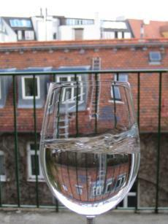
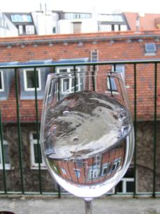
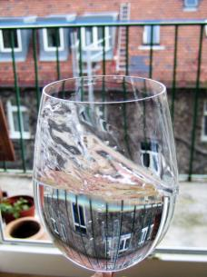
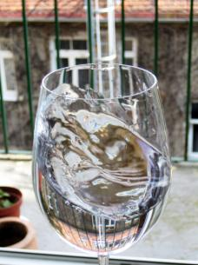
III.
Visualisation
4)
GPU-based isosurface raytracing
so we are able to do isosurface ray-tracing now
what could we use this for?
answer: ray-tracing is perfect for rendering optical effects at water surfaces

Slide 98
III.
Visualisation
4)
GPU-based isosurface raytracing
optical appearance of water results mainly from reflection and refraction
three questions must be answered when a view ray (or light ray) hits a water surface:
which direction has the reflected ray?
which direction has the refracted ray?
how is the light distributed among the rays?

Slide 99
III.
Visualisation
4)
GPU-based isosurface raytracing
which direction has the reflected ray?
law of reflection

Slide 100
III.
Visualisation
4)
GPU-based isosurface raytracing
which direction has the refracted ray?
Snell’s law (law of refraction)
Notes:
explain everything unhurriedly

Slide 101
III.
Visualisation
4)
GPU-based isosurface raytracing
how is the light distributed among the rays?
Fresnel equations
Notes:
theta_t derived from theta_i with Snell’s law

Slide 102
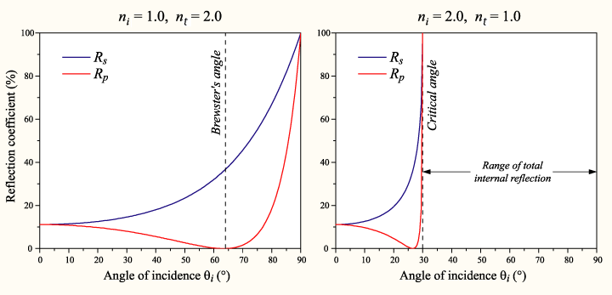
III.
Visualisation
4)
GPU-based isosurface raytracing
plot of reflectance for refraction ratio 1/2 and 2/1
reflectance for unpolarised light:

Slide 103
III.
Visualisation
4)
GPU-based isosurface raytracing
combining all that equations leads:
remembering Snell’s law, define c and g as:
results in the so called Fresnel term:
Notes:
note that different definitions of c and g exist

Slide 104
III.
Visualisation
4)
GPU-based isosurface raytracing
for n_{i} < n_{t} it can be approximated with:

Slide 105
III.
Visualisation
4)
GPU-based isosurface raytracing
overall effect:

Slide 106
III.
Visualisation
4)
GPU-based isosurface raytracing
overall effect on real water surfaces

Slide 107
III.
Visualisation
4)
GPU-based isosurface raytracing
ray-tracing depth

Slide 108
III.
Visualisation
4)
GPU-based isosurface raytracing
implementation
void fp_RenderRaytrace::OnD3D10FrameRender(
ID3D10Device* D3DDevice,
const D3DXMATRIX* View,
const D3DXMATRIX* Projection,
const D3DXMATRIX* ViewProjection,
const D3DXMATRIX* InvView,
bool UpdateVis) {
RenderEnvironment(D3DDevice, View, Projection);
if(UpdateVis)
FillVolumeTexture(D3DDevice);
RenderVolume(D3DDevice, View, ViewProjection, InvView);
}

Slide 109
III.
Visualisation
4)
GPU-based isosurface raytracing
RenderVolume simply renders bounding box two times
first time: back-faces -> ray exit
second time: front-faces -> main ray-tracing
ray-tracing therefore begins with ray entry and exit point

Slide 110
III.
Visualisation
4)
GPU-based isosurface raytracing
ray-tracing steps
define step-size
calculate offset vector (from one sample to the next)
sample along the ray in a loop (beginning with the entry)
stop the loop is a sample value higher than isolevel is found
if now intersection is found, discard the fragment
refine the intersection with binary search between the last two sample points
Calculate surface normal from the gradient

Slide 111
III.
Visualisation
4)
GPU-based isosurface raytracing
ray-tracing steps continued
calculate reflection direction (used later for environment-map lookup)
calculate refraction direction
calculate volume exit point of refraction ray (ray-box intersect test)
perform second iso-surface raycast along the refraction ray
leads to exit intersection with isosurface
calculate reflection direction for exit intersection
evaluate Fresnel term for exit i.
Notes:
note memory latency hiding

Slide 112
III.
Visualisation
4)
GPU-based isosurface raytracing
ray-tracing steps continued
if second refraction ray exists (no total internal reflection) calculate its direction
calculate the first Fresnel term
sample reflection 1, reflection 2 and refraction 2 (if existent) colour-values from the environment map
combine the colours according to the two Fresnel terms

Slide 113
III.
Visualisation
4)
GPU-based isosurface raytracing
optical results

Slide 114
III.
Visualisation
4)
GPU-based isosurface raytracing
colour-coded results

Slide 115
III.
Visualisation
4)
GPU-based isosurface raytracing
demonstration?

Slide 116
III.
Visualisation
4)
GPU-based isosurface raytracing
performance results
test machine:
CPU: Intel Core 2 Quad Q6600 @ 3.2 GHz
RAM: 2 GB
Graphics card: Nvidia Geforce 8880 GT 512 MB video memory
GPU clock s.: core 640 / shader 1600 / memory 950 MHz
OS: Windows Vista x64 (program is x64 binary)
render options
screen-mode: 1280x1024 full-screen
simulation: all possible forces, 1728 (12³) particles
visualisation: all possible effects

Slide 117
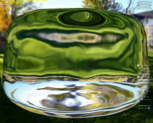
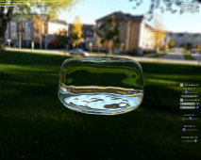
III.
Visualisation
4)
GPU-based isosurface raytracing
performance results continued
water surface rendered screen filling: 65 FPS
1/9 screen coverage: 161 FPS
water surface off-screen: 288 FPS (6% slower then sprite rendering)
memory latency hiding effects:
performance depends more on core- & shader- then memory clock
nonetheless longer computations before texture sampling are “for free”

Slide 118
III.
Visualisation
4)
GPU-based isosurface raytracing
pros
sufficient performance
view dependent approach
implicit LOD
very good optical results
smooth water surface
minimal grid related motion artefacts
optical effect quality that is normally only known from offline ray-tracers

Slide 119
III.
Visualisation
4)
GPU-based isosurface raytracing
cons
no empty space skipping
on the fly octree generation costly
limited spatial flexibility
spatial limited grid needed
optical interaction with 3D environment difficult
ray-tracing hard to seamlessly integrate into rasterised renderer

Slide 120
III.
Visualisation
4)
GPU-based isosurface raytracing
further work
develop real-time empty space skipping
break spatial limitations
build only one grid for the whole view
in normalised device space
allow optical interaction with 3D environment
outgoing rays:
on-the-fly environment map
spatially limited again
some sort of ray-tracing
internal rays:
parallax occlusion mapping for depth buffer?
some sort of ray-tracing

Slide 121
III.
Visualisation
4)
GPU-based isosurface raytracing
outlook
interest in realtime ray-tracing is growing
hardware and APIs become more general in the future
perhaps isosurface ray-tracing easier to integrate into renderers of the future

Slide 122
Contents
Introduction
Fluid simulation
Visualisation
Target graphics APIs
Direct particle rendering
Isosurface rendering with marching cubes
GPU-based isosurface raytracing
GPU-based volumetric density field construction
Alternatives and further work
Conclusion

Slide 123
III.
Visualisation
5)
GPU-based volumetric density field construction
we have left out GPU-based density field construction
because it’s a more general technique
could be interesting for many visualisations
crucial for the overall performance
CPU version showed how it shouldn’t be
algorithm is highly parallelisable and extremely dependent on memory performance
best case for GPGPU

Slide 124
III.
Visualisation
5)
GPU-based volumetric density field construction
basic principle:
for each particle
find out how much slices of the volumetric density texture are influenced by the particle
for every influenced slice construct a square that covers the affected area
rasterise the square onto the right slice
for every fragment check the distance to the particle centre
and compute the additional density from the SPH-density-equation

Slide 125
III.
Visualisation
5)
GPU-based volumetric density field construction
implementation
use instanced draw
instance-count = number of slices influenced by single particle
use geometry shader
constructs billboards for affected slice regions
chooses the target slice (render-target index)
pixel shader computes additional density
put most of density equation into 1D texture
use additive blending
mimics summation

Slide 126
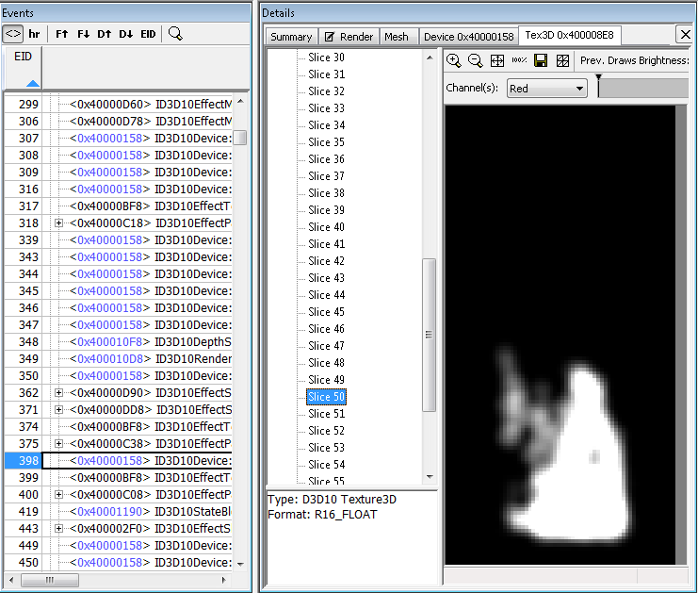
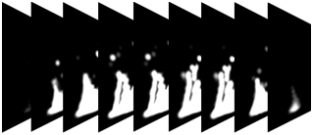
III.
Visualisation
5)
GPU-based volumetric density field construction
results
2016 particles
grid texture size 64x128x64
particle voxel diameter 13
texture fill only: 614 FPS (compared to 850 “doing nothing”)
simulation only: 285 FPS sim. + texture fill: 273 FPS
-> sufficient performant

Slide 127
III.
Visualisation
6)
Alternatives and further work
many alternative techniques for isosurface rendering
surface splatting for example
evaluating each for its usability in realtime particle based fluid simulation would be way out of scope
interesting approach from Müller 2007: screen-space-meshes
no density grid built
operates only in 2D screen space
instead of finding an isosurface, particles are drawn as (imaginary) spheres and a smoothed mesh is built from the result

Slide 128
III.
Visualisation
6)
Alternatives and further work
major advantage of screen-space-meshes:
nothing is created that could be used for more than the current view
-> good idea for realtime visualisation of realtime simulation
interesting idea:
combine something like s. s. m. with “interactive screen space photon tracing” (Krüger, Bürger, Westermann 2006)
supports meshes, supports reflections and refractions, supports related caustics and god-rays

Slide 129
Contents
Introduction
Fluid simulation
Visualisation
Conclusion

Slide 130
IV.
Conclusion
thesis demonstrated how it’s possible to:
interactively simulate fluids (especially liquids)
render the results in ray-tracing quality
prediction:
Within a few years, fluid simulation will be seen in many interactive applications (especially video games).
interesting side note:
Matthias Müller is the head of research at AGEIA
Nvidia recently bought AGEIA
free CUDA accelerated particle based fluid simulation to come soon?
be prepared with good visualisations ;-)

Slide 131

fin

